Slide 1
EE-451: Image Analysis and Pattern Recognition
Group 17:
Said MAHMOUD
Ben Haj Yahia AHMED

Slide 2
STEPS :
Load data
Preprocess data
Segmentation and object detection
Assign cards/dealer to players
Classifying Suites
Classifying Numbers
Results
Notes:
Loading data and creating database ❑ Preprocessing Images: cropping, contrast adaptation, morphological filtering … ❑ Extracting card dand dealer tag shapes based on contour detection ❑ Finding dealer ❑ Separating numbers and symbols from card images ❑ Classification of numbers and symbols separately

Slide 3
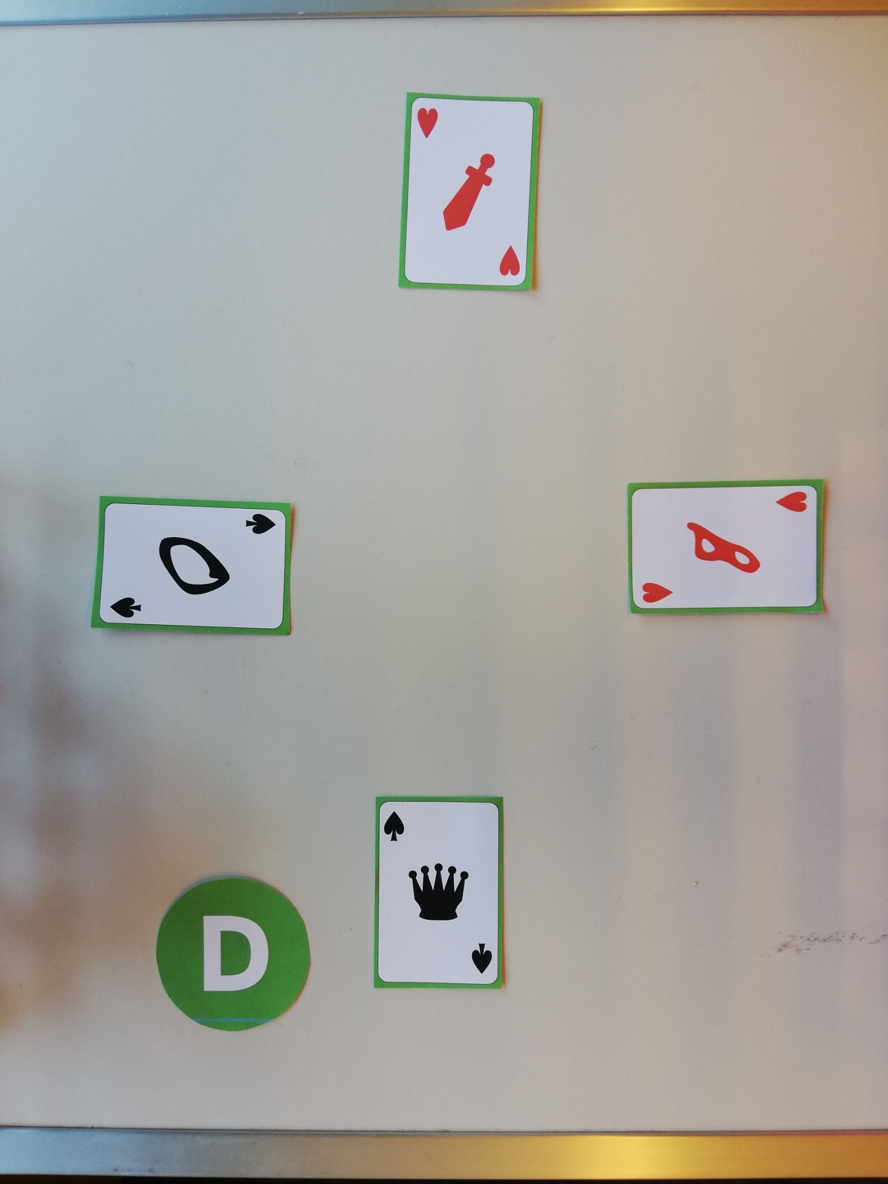
Loading data
The whole implemented process is done iteratively.
For each game, we iterate over the rounds images and apply our methods:
Adaptive thresholding
Contour detection
Object labeling
for each card we extract suite and number
Original image game 1 round 1

Slide 4
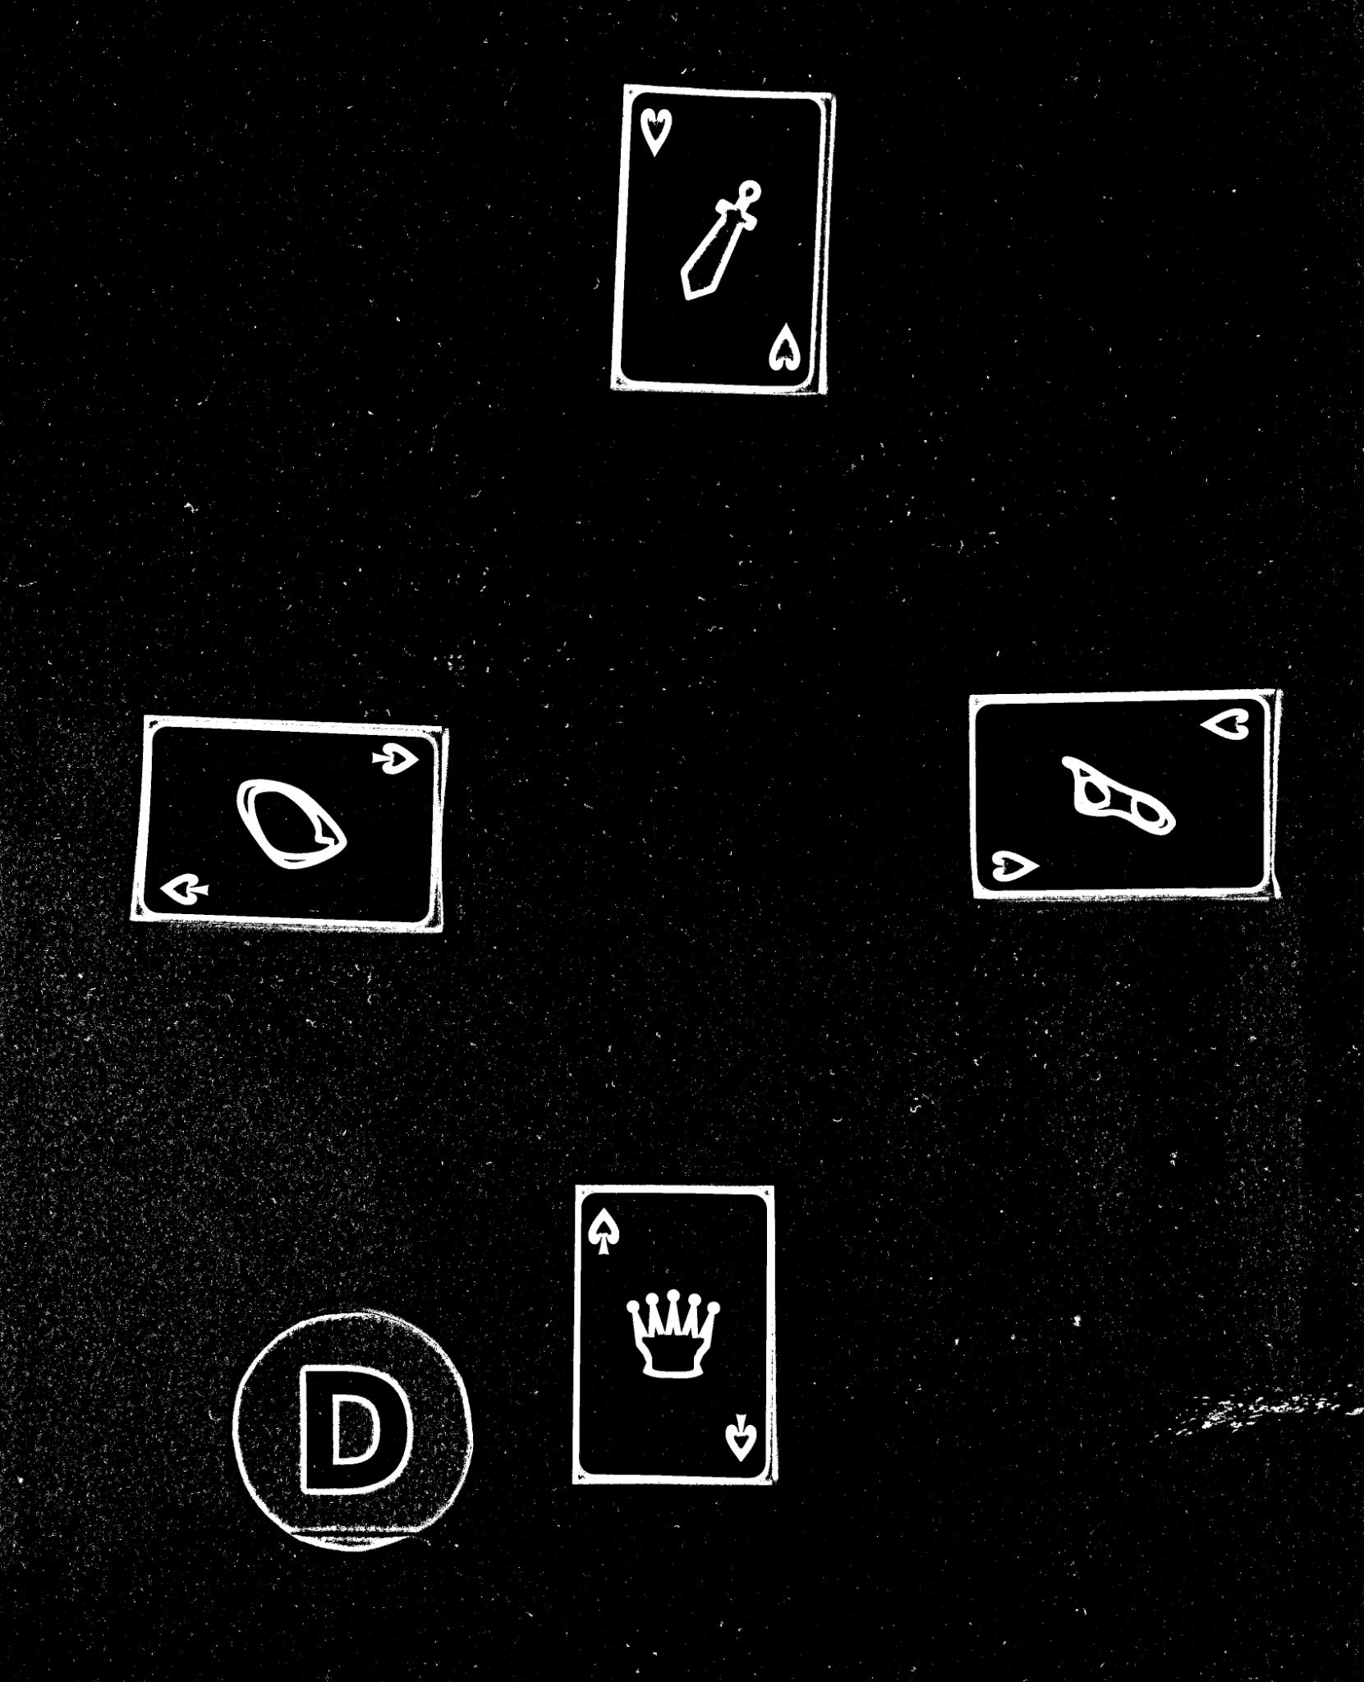
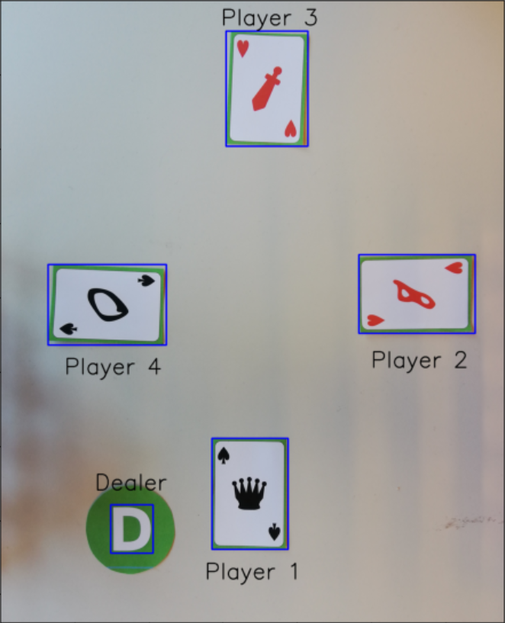
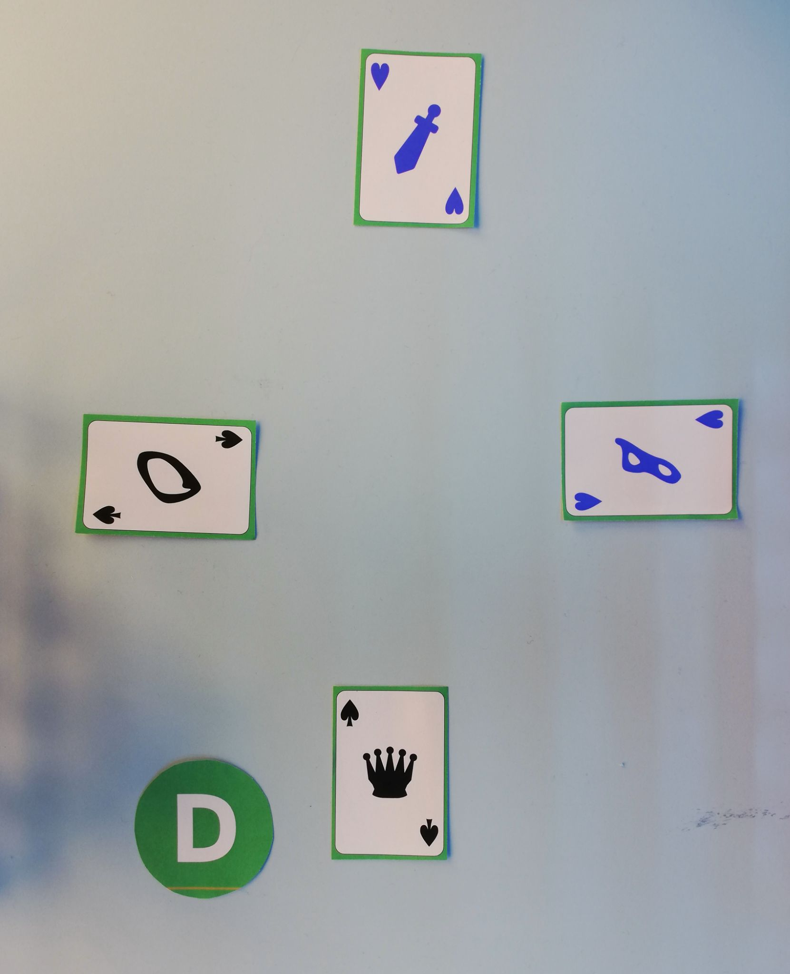
Pre-processing, segmentation and object labeling
First, we apply adaptive thresholding and inverse the result
Then, find contours and assign each card to the corresponding player
Finally, we crop the image and apply filter to classify red and black cards
Notes:
First pipeline: crop + adaptive threshold + opening (3, 3) + closing + closing on edges -> Segmentation -> Filter overlapping contours + Get biggest areas + identify dealer using green ratio
Object labeling: Get centers of contours to assign players
Second preprocessing: Crop + Filter by color -> Segmentation

Slide 5
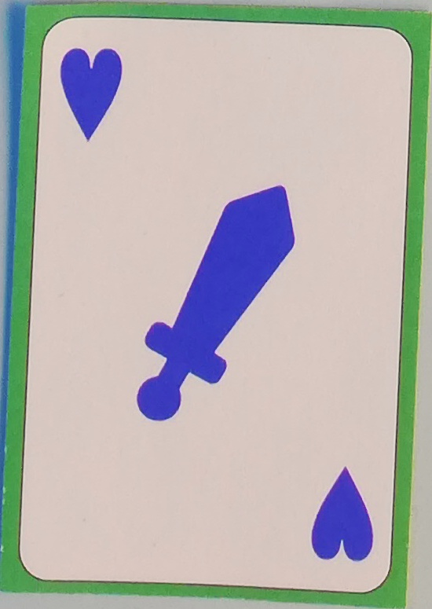


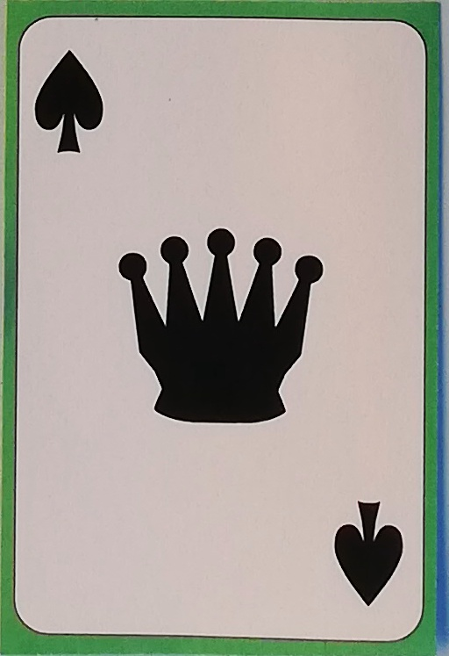

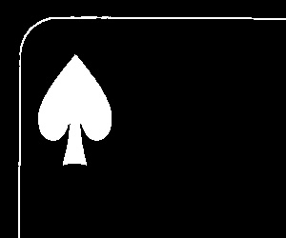
Extracting suites and numbers
We rotate the card when needed, then crop it to extract the number and the suit

Slide 6
Classifying Numbers
Object descriptors:
The output of a Convolutional Neural net that was trained on the MNIST dataset
The magnitude of 10 Fourier descriptors (the 2nd to the 11th).
Model:
XGBoost (Extreme Gradient boost) trained on the concatenated descriptors as features
Evaluation:
5-Fold cross validation yielded an accuracy of 93.5%

Slide 7
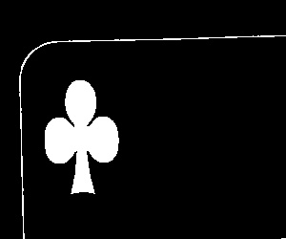
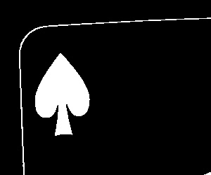


Classifying Suites
We find apply morphological operations (opening then closing) and find contours, then depending on the area we classify our suite.
For Black suites : Spade if area>=4900 else Clubs (95% accuracy)
For Red suites : Heart if area>=4065 else Diamond (98.9% accuracy

Slide 8
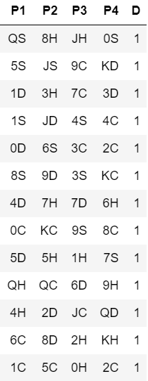
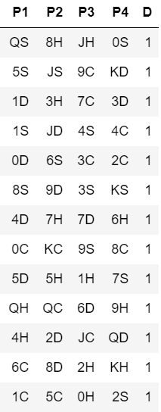
Results for game 1
Predictions
Ground truth
Players points (standard): [2 6 2 5]
Players points (advanced): [7 3 2 1]
Model’s accuracy is:
Standard=1.000
Advanced=0.969

